Slide 1
Inha University in Tashkent
Theme 1: Introduction to Philosophy
Tashkent – 2026

Slide 2
Outline:
Definition of the Term and Its Interpretations
The Role of Philosophy in the Formation of Sciences
Methods and the Doctrines of Philosophy

Slide 3


What is Philosophy?
The term philosophy is derived from Greek words “phileo” – love and “sophia” – wisdom that literally means “love of wisdom”.
The main aim of the philosophy is to study of general and fundamental issues such as existence (ontology), knowledge (epistemology), values (ethics), reason (logic), mind and language.
It should be noted that each of these problems is the separate branch of the subject.

Slide 4
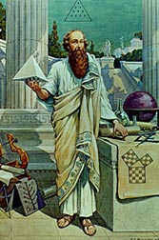
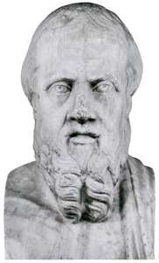
The Usage of the Term and Its Definition
The term was used firstly by prominent scholar Pythagoras (c. 570-495 BC). In particular, he noted: “Life ... is like a festival: some come to compete in it, some to trade, and the happiest to watch”. So, according to Pythagoras, the meaning of philosophy is the search for truth.
Indeed, the Greek historian Herodotus (484-424 BC) appears to have been the first to use the verb “to philosophize” which denoted “to observe”.
The famous ancient Greek thinker Plato (428 / 427-347 BC) said that the task of philosophy is to know the eternal and absolute truths, which only philosophers, who are endowed with the appropriate wise soul.
According to Aristotle (384-322 BC), the task of philosophy is the comprehension of the universal in the world itself, and its subject is the first principles and reasons for being.

Slide 5
The Role of Philosophy in the System of Sciences
Philosophy is one of the most ancient disciplines and it referred to any body of knowledge. Therefore, philosophy is closely related to mathematics, natural sciences, religion and politics.
Philosophy was traditionally divided into three major branches in Classical period:
Natural philosophy was the study of the physical world. During long historical period, natural philosophy has birthed the various natural sciences such as astronomy, physics, chemistry, biology and cosmology.
Moral/or ethics philosophy was the branch that investigates the issues: goodness, justice, right and wrong. Moral philosophy has split into the social sciences, especially, ethics and political philosophy.
Metaphysical philosophy concerned abstract objects such as existence, logic, causation. Metaphysical philosophy has birthed formal sciences such as logic, mathematics and philosophy of science
In the modern era, some branches that were traditionally part of philosophy became separate academic disciplines, including psychology, sociology, linguistics and economics.

Slide 6
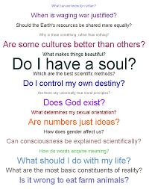
Questions of Philosophy
There are general questions that reveal the nature of philosophical thinking.
First of all, among them is the question of: what is primary: the spirit or matter, ideal or material?
From its solution depends the general understanding of being, the material and the ideal are its ultimate characteristics.
The question of the primordial origins of being is also connected with the question and approaches of monism, dualism and pluralism.

Slide 7


Monism (from the Greek monos - one, only) is a philosophical concept, according to which the world has one beginning. This is the beginning of a material or spiritual substance. Hence it follows that monism can, respectively, be of two kinds - materialistic and idealistic. The first, the ideal derives from the material. According to the second, the material is due to the ideal, spiritual. It is confronted with the problem of proving the creation of the world with the spirit (consciousness, idea, God), which cannot be positively solved within the framework of modern science.
Dualism (from Latin dualis - dual) is a philosophical doctrine that affirms the equality of the two principles: matter and consciousness, physical and mental. So, for example, R. Descartes believed that the basis of being are two equal sub-stations: the thinking (spirit) and the matter.
Pluralism (from Latin pluralis - pluralis) - suggests several or many initial bases. It is based on the assertion of the plurality of bases and the beginning of being. An example of this is the theories of ancient thinkers who put forward such diverse foundations as ground for everything, such as earth, water, air, fire, etc.

Slide 8
Methods of Philosophy
Each science has its own method. It can be said that the philosophical method (from the Greek «methodos» - the path of knowledge) is a system of the most common methods of theoretical and actual development of reality, as well as a way of constructing and substantiating the system of the philosophical knowledge.
Like the methods of other sciences, it originates in the practical activities of people and its source is a reflection of the logic and laws of the development of objective reality.
There are following methods of epistemology:
Sensualism (from Latin «sensus» - feeling) is a methodological principle in which feelings are taken as the basis of knowledge and which attempts to infer all knowledge from the activity of sense organs, sensations, absolutizing their role in cognition.
Rationalism (from the Latin «ratio» - mind) is a method according to which the basis of the cognition and action of people is the mind.
Irrationalism is a philosophical method that denies, or at least limits the role of reason in cognition, but focuses on the irrational ways of comprehending being.

Slide 9
Thank you for your attention!

